Slide 1
Arrays
Chapter 7

Slide 2
Objectives
Nature and purpose of an array
Using arrays in Java programs
Methods with array parameter
Methods that return an array
Array as an instance variable
Use an array not filled completely

Slide 3
Objectives
Order (sort) the elements of an array
Search an array for a particular item
Define, use multidimensional array
Text fields, text areas in applets
Drawing arbitrary polygons in applets

Slide 4
Array Basics: Outline
Creating and Accessing Arrays
Array Details
The Instance Variable length
More About Array Indices
Analyzing Arrays

Slide 5

Array
An array is a collection of variables of the same type.
The name of the array is a reference type.
Type of Array
Name of Array
Size of Array
Subscript
Number of elements in array

Slide 6
Array
Array elements are are stored in consecutive memory locations.
temperature [0]
temperature [1]
temperature [2]
temperature [3]
temperature [4]
temperature [5]
temperature [6]

Slide 7
Accessing an element of an array
To access an element of an array, you need to specify the name of the array and the position of the element in the array.
To access the fifth element of the array: temperature [4] = 40;
40
Name of Array
Index of the element

Slide 8
Accessing an element of an array
Array index can be an integer number or any expression that return an integer number
To access the fifth element of the array: temperature[a+b] = 40;
Name of Array
Index of the element
An index must be an int value or a value of a type that can be promoted to int—namely, byte, short or char, but not long; otherwise, a compilation error occurs.

Slide 9

Declaring and creating arrays
Syntax for declaring an array with new
The number of elements in an array is its length
The type of the array elements is the array's base type

Slide 10
Declaring and creating arrays
int [] arr = new int [10]
int arr [] = new int [10]
int [] arr;
arr = new int [10]
int [] arr = {1,2,3,4,5,6,7,8,9,10};

Slide 11
Declaring and creating arrays
int [] arr = new int [10]
int arr [] = new int [10]
int [] arr;
arr = new int [10]
int [] arr = {1,2,3,4,5,6,7,8,9,10};
Every array is associated with a variable called length that returns the number of elements in that array. You can write as follows: arr.length

Slide 12
Creating and Accessing Arrays
An array is a special kind of object
Think of as collection of variables of same type
Creating an array with 7 variables of type double
To access an element use
The name of the array
An index number enclosed in braces
Array indices begin at zero

Slide 13
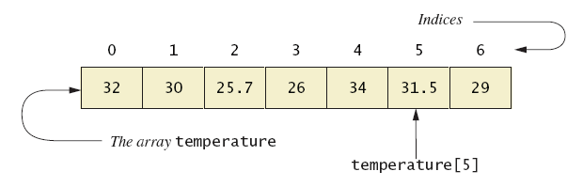
Creating and Accessing Arrays
Figure 7.1 A common way to visualize an array
Note sample program, listing 7.1 class ArrayOfTemperatures

Slide 14
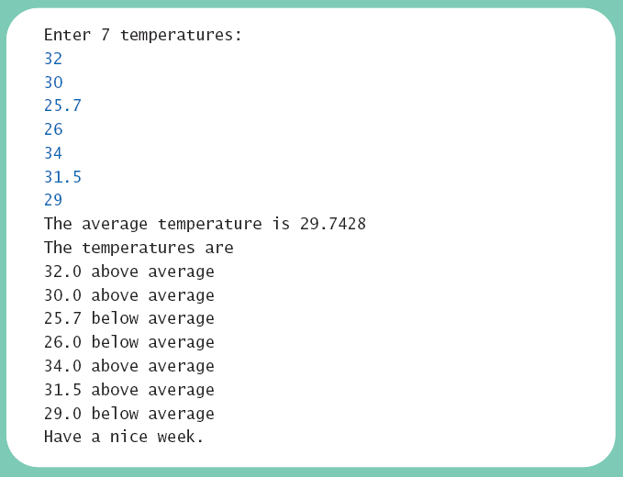
Creating and Accessing Arrays
Sample screen output

Slide 15
Array Details
Syntax for declaring an array with new
The number of elements in an array is its length
The type of the array elements is the array's base type

Slide 16
Square Brackets with Arrays
With a data type when declaring an array int [ ] pressure;
To enclose an integer expression to declare the length of the array pressure = new int [100];
To name an indexed value of the array pressure[3] = keyboard.nextInt();

Slide 17
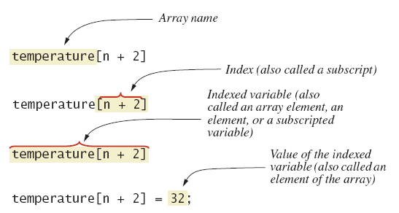
Array Details
Figure 7.2 Array terminology

Slide 18
The Instance Variable length
As an object an array has only one public instance variable
Variable length
Contains number of elements in the array
It is final, value cannot be changed
Note revised code, listing 7.2 class ArrayOfTemperatures2

Slide 19
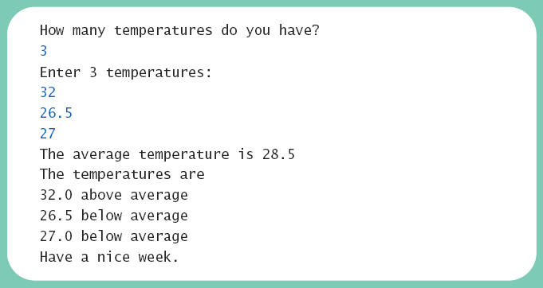
The Instance Variable length
Sample screen output

Slide 20
More About Array Indices
Index of first array element is 0
Last valid Index is arrayName.length – 1
Array indices must be within bounds to be valid
When program tries to access outside bounds, run time error occurs
OK to "waste" element 0
Program easier to manage and understand
Yet, get used to using index 0

Slide 21
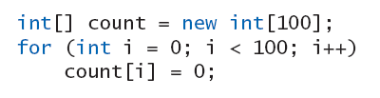
Initializing Arrays
Possible to initialize at declaration time
Also may use normal assignment statements
One at a time
In a loop

Slide 22
Arrays in Classes and Methods: Outline
Case Study: Sales Report
Indexed Variables as Method Arguments
Entire Arrays as Arguments to a Method
Arguments for the Method main
Array Assignment and Equality
Methods that Return Arrays

Slide 23
Case Study: Sales Report
Program to generate a sales report
Class will contain
Name
Sales figure
View class declaration, listing 7.3 class SalesAssociate

Slide 24
Case Study: Sales Report
Main subtasks for our program
Get ready
Obtain the data
Compute some statistics (update instance variables)
Display the results

Slide 25
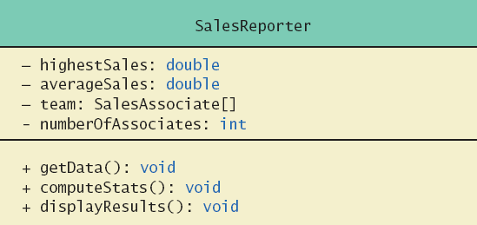
Case Study: Sales Report
Figure 7.3 Class diagram for class SalesReporter

Slide 26
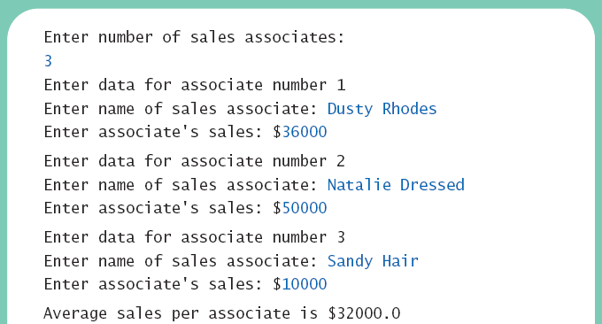
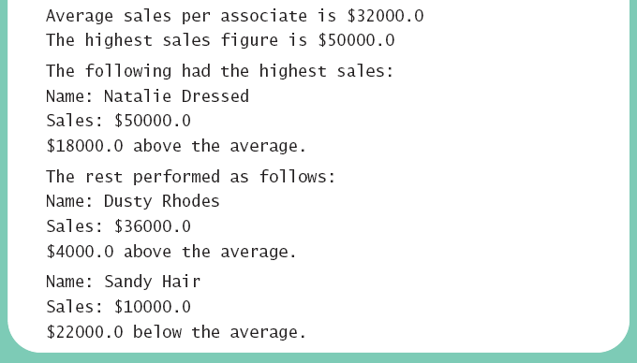
Case Study: Sales Report
View sales report program, listing 7.4 class SalesReporter
Sample screen output

Slide 27
Indexed Variables as Method Arguments
Indexed variable of an array
Example … a[i]
Can be used anywhere variable of array base type can be used
View program using indexed variable as an argument, listing 7.5 class ArgumentDemo

Slide 28
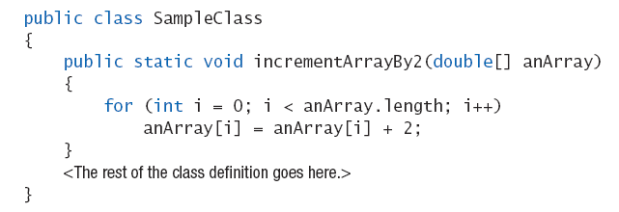
Entire Arrays as Arguments
Declaration of array parameter similar to how an array is declared
Example:

Slide 29
Entire Arrays as Arguments
Note – array parameter in a method heading does not specify the length
An array of any length can be passed to the method
Inside the method, elements of the array can be changed
When you pass the entire array, do not use square brackets in the actual parameter

Slide 30
Arguments for Method main
Recall heading of method main public static void main (String[] args)
This declares an array
Formal parameter named args
Its base type is String
Thus possible to pass to the run of a program multiple strings
These can then be used by the program

Slide 31
Array Assignment and Equality
Arrays are objects
Assignment and equality operators behave (misbehave) as specified in previous chapter
Variable for the array object contains memory address of the object
Assignment operator = copies this address
Equality operator == tests whether two arrays are stored in same place in memory

Slide 32

Array Assignment and Equality
Two kinds of equality
View example program, listing 7.6 class TestEquals
Sample screen output

Slide 33
Array Assignment and Equality
Note results of ==
Note definition and use of method equals
Receives two array parameters
Checks length and each individual pair of array elements
Remember array types are reference types

Slide 34
Gotcha – Don’t Exceed Array Bounds
The code below fails if the user enters a number like 4. Use input validation.
Scanner kbd = new Scanner(System.in);
int[] count = {0,0,0,0};
System.out.println("Enter ten numbers between 0 and 3.");
for (int i = 0; i < 10; i++)
{
int num = kbd.nextInt();
count[num]++;
}
for (int i = 0; i < count.length; i++)
System.out.println("You entered " + count[i] + " " + i + "'s");

Slide 35
Gotcha – Creating an Array of Objects
When you create an array of objects Java does not create instances of any of the objects! For example, consider the code:
We can’t access team[0] yet; it is null. First we must create references to an object:
we can now access team[0].getName() or team[1].getSalary()
SalesAssociate[] team = new SalesAssociate[10];
team[0] = new SalesAssociate("Jane Doe", 5000); team[1] = new SalesAssociate("John Doe", 5000);

Slide 36
Methods that Return Arrays
A Java method may return an array
View example program, listing 7.7 class ReturnArrayDemo
Note definition of return type as an array
To return the array value
Declare a local array
Use that identifier in the return statement

Slide 37
Programming with Arrays and Classes: Outline
Programming Example: A Specialized List Class
Partially Filled Arrays

Slide 38
Programming Example
A specialized List class
Objects can be used for keeping lists of items
Methods include
Capability to add items to the list
Also delete entire list, start with blank list
But no method to modify or delete list item
Maximum number of items can be specified

Slide 39
Programming Example
View demo program, listing 7.8 class ListDemo
Note declaration of the list object
Note method calls

Slide 40
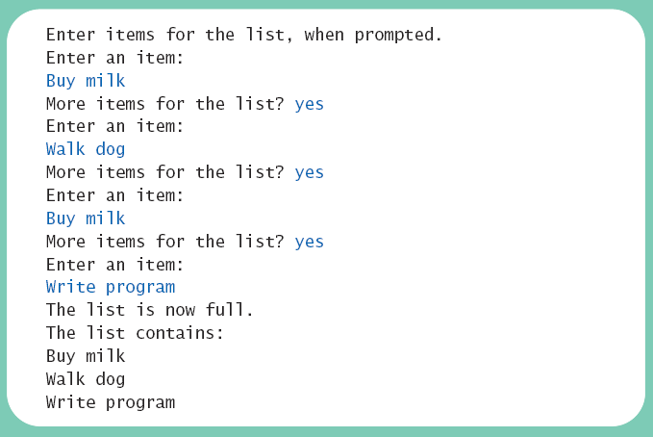
Programming Example
Sample screen output

Slide 41
Programming Example
Now view array wrapped in a class to represent a list, listing 7.9 class OneWayNoRepeatsList
Notable code elements
Declaration of private array
Method to find n^{th} list item
Method to check if item is on the list or not

Slide 42
Partially Filled Arrays
Array size specified at definition
Not all elements of the array might receive values
This is termed a partially filled array
Programmer must keep track of how much of array is used

Slide 43
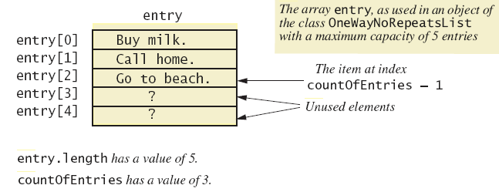
Partially Filled Arrays
Figure 7.4 A partially filled array

Slide 44
Sorting, Searching Arrays: Outline
Selection Sort
Other Sorting Algorithms
Searching an Array

Slide 45
Selection Sort
Consider arranging all elements of an array so they are ascending order
Algorithm is to step through the array
Place smallest element in index 0
Swap elements as needed to accomplish this
Called an interchange sorting algorithm

Slide 46
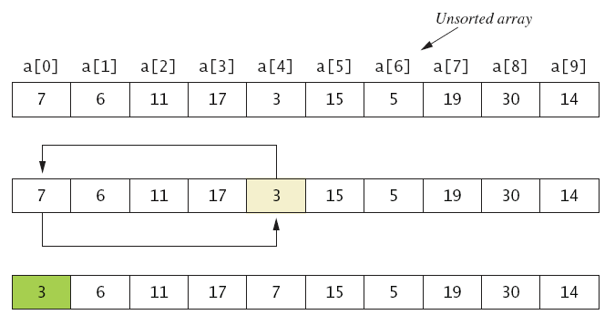
Selection Sort
Figure 7.5a

Slide 47
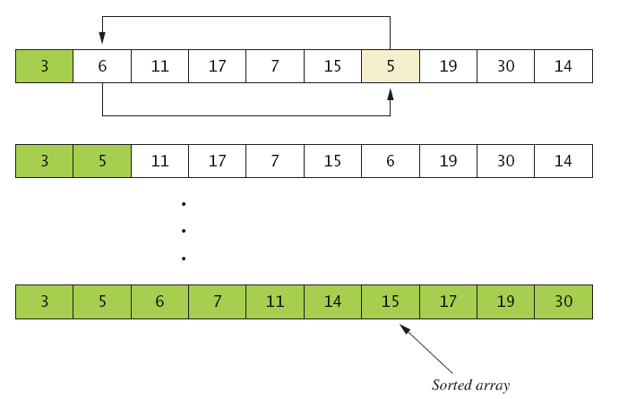
Selection Sort
Figure 7.5b
. . .

Slide 48
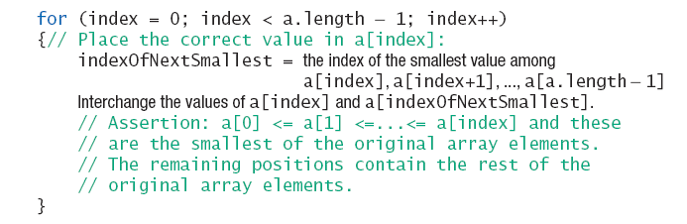
Selection Sort
Algorithm for selection sort of an array

Slide 49
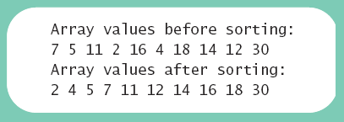
Selection Sort
View implementation of selection sort, listing 7.10 class ArraySorter
View demo program, listing 7.11 class SelectionSortDemo
Sample screen output

Slide 50
Other Sorting Algorithms
Selection sort is simplest
But it is very inefficient for large arrays
Java Class Library provides for efficient sorting
Has a class called Arrays
Class has multiple versions of a sort method

Slide 51
Searching an Array
Method used in OneWayNoRepeatsList is sequential search
Looks in order from first to last
Good for unsorted arrays
Search ends when
Item is found … or …
End of list is reached
If list is sorted, use more efficient searches

Slide 52
Multidimensional Arrays: Outline
Multidimensional-Array Basics
Multidimensional-Array Parameters and Returned Values
Java's Representation of Multidimensional
Ragged Arrays
Programming Example: Employee Time Records

Slide 53
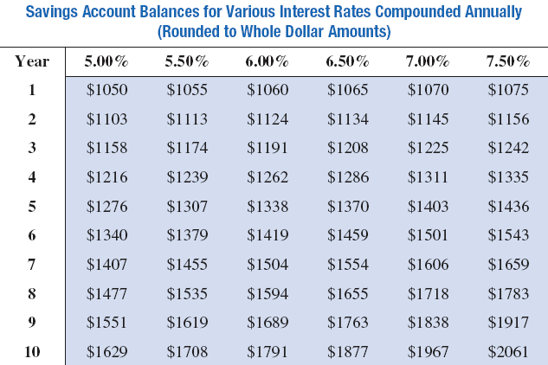
Multidimensional-Array Basics
Consider Figure 7.6, a table of values

Slide 54
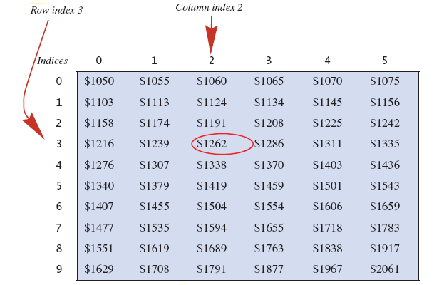
Multidimensional-Array Basics
Figure 7.7 Row and column indices for an array named table
table[3][2] has a value of 1262

Slide 55
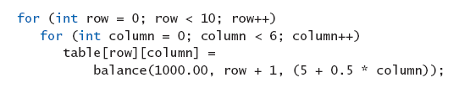
Multidimensional-Array Basics
We can access elements of the table with a nested for loop
Example:
View sample program, listing 7.12 class InterestTable

Slide 56
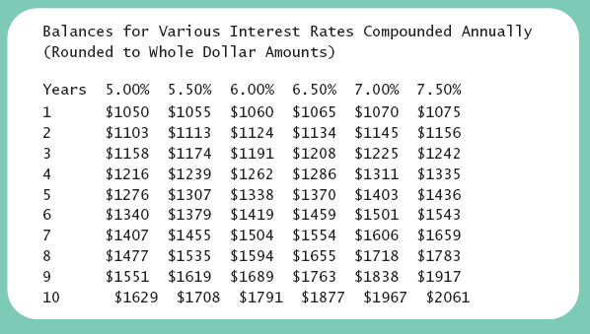
Multidimensional-Array Basics
Sample screen output

Slide 57
Multidimensional-Array Parameters and Returned Values
Methods can have
Parameters that are multidimensional-arrays
Return values that are multidimensional-arrays
View sample code, listing 7.13 class InterestTable2

Slide 58
Java's Representation of Multidimensional Arrays
Multidimensional array represented as several one-dimensional arrays
Given int [][] table = new int [10][6];
Array table is actually 1 dimensional of type int[]
It is an array of arrays
Important when sequencing through multidimensional array

Slide 59
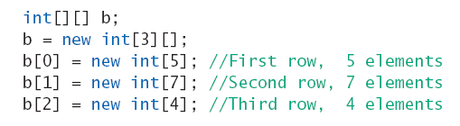
Ragged Arrays
Not necessary for all rows to be of the same length
Example:

Slide 60
Programming Example
Employee Time Records
Two-dimensional array stores hours worked
For each employee
For each of 5 days of work week
Array is private instance variable of class
View sample program, listing 7.14 class TimeBook

Slide 61
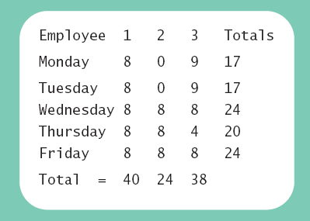
Programming Example
Sample screen output

Slide 62
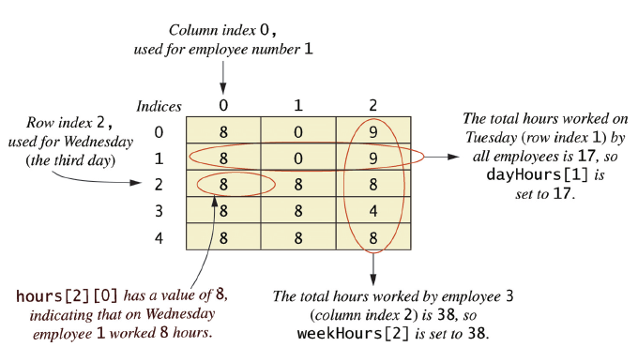
Programming Example
Figure 7.8 Arrays for the class TimeBook

Slide 63
Graphics Supplement: Outline
Layout Panes
Vbox
Hbox
StackPane
FlowPane
GridPane
BorderPane
Combining Layouts
The Classes TextArea and TextField
Drawing Polygons

Slide 64
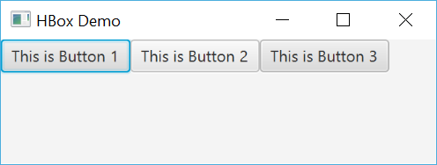
HBox Layout
Layout panes control how components are laid out and displayed in a JavaFX application
We’ve already seen VBox, which arranges components vertically
The HBox layout arranges components horizontally
View sample code, listing 7.15, class HBoxDemo

Slide 65
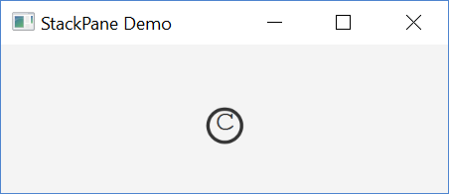
StackPane Layout
The StackPane layout stacks components on top of one another
This provides a way to overlay text onto a shape or image to create a more complex object
View sample code, listing 7.16, class StackPaneDemo
Overlay c onto an O

Slide 66
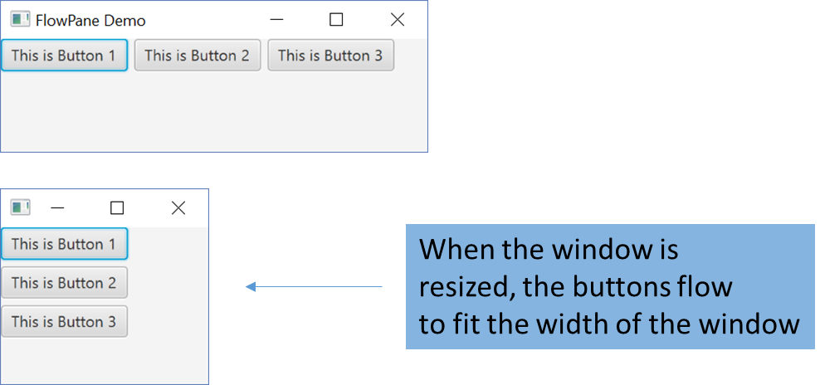
FlowPane Layout
The FlowPane layout adds components left to right and wraps around to the left when the right side of the screen is reached
You can control the amount of vertical and horizontal space between elements by using the methods setVgap and setHgap
View sample code, listing 7.17, class FlowPaneDemo

Slide 67
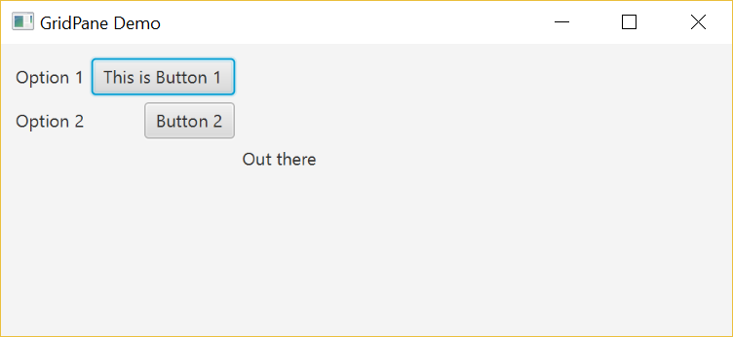
GridPane Layout
The GridPane layout arranges components into a grid of rows and columns that are accessible like a 2D array
The upper left cell is at 0,0;
“Out there” is at 2,2
This is Button 1 is at 1,0
View sample code, listing 7.18, class GridPaneDemo

Slide 68
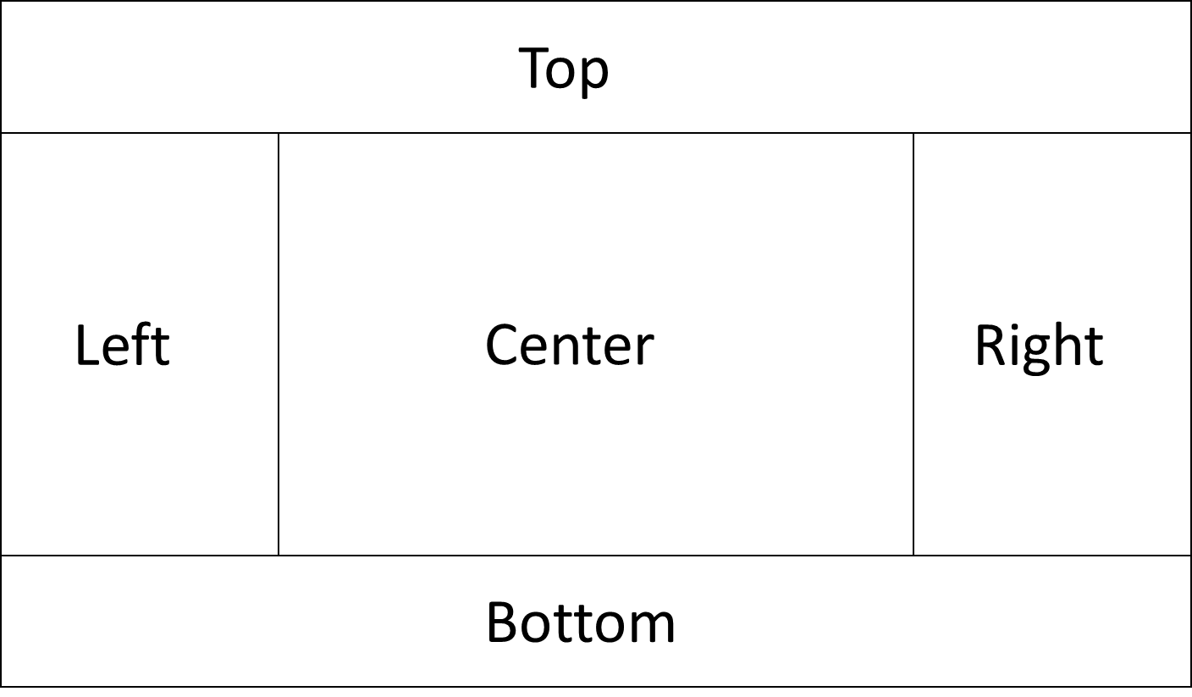
BorderPane Layout
The BorderPane layout places items into the five regions shown below. Unused regions take up no space.
View sample code, listing 7.19, class BorderPaneDemo

Slide 69
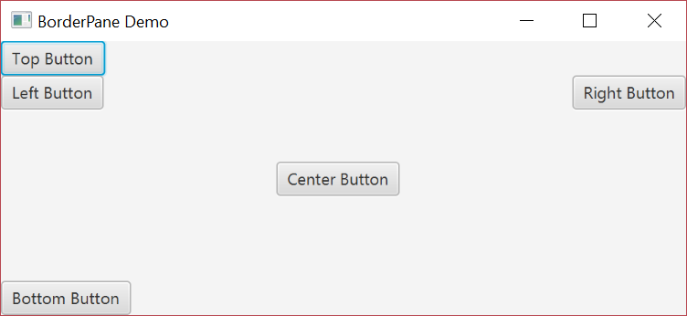
BorderPane Layout
BorderPaneDemo Output

Slide 70
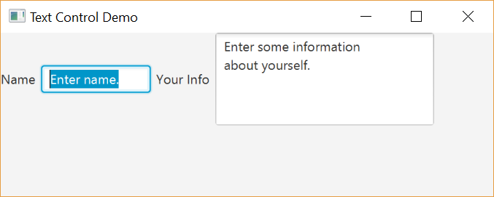
Text Areas, Text Fields
Text area is object of class TextArea
Displayed as a place for user to enter multiple lines of text
Text area is object of class TextField
Displayed as a place for user to enter a single line of text
Can place into layouts
View sample code, listing 7.20, class TextControlDemo

Slide 71
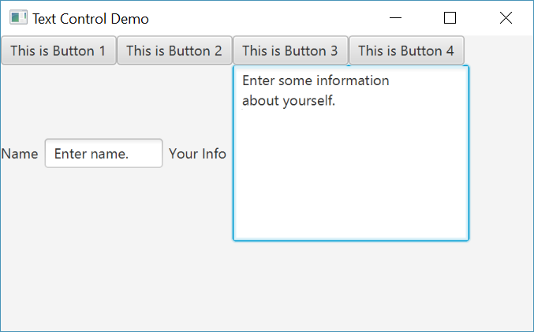
Combining Layout
Layouts can be added as a component inside another layout, giving you the flexibility to create sophisticated interfaces
View sample code, listing 7.21, class CombinedLayoutDemo, which embeds an HBox and FlowPane into a BorderPane

Slide 72
Drawing Polygons
Class GraphicsContext has method strokeRect
But only 4 sides and only 90 degree corners
Method strokePolygon can draw polygon of any number of sides
Three arguments
Array of double for x values of coordinates
Array of double for y values of coordinates
Number of points (vertices)
A polyline like a polygon, not closed

Slide 73
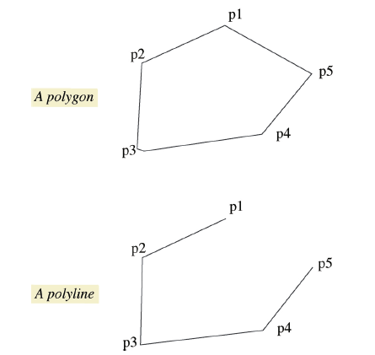
Drawing Polygons
Figure 7.10 A polygon and a polyline

Slide 74
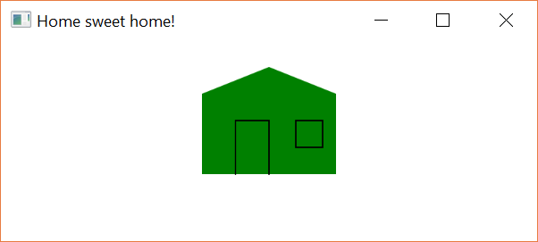
Drawing Polygons
View sample application, listing 7.22 class PolygonDemo
House is a filled polygon
Door is a polyline
Window is an ordinary polygon
Sample screen output

Slide 75
Summary
An array is a collection of variables all of the same type
Arrays are objects, created with operator new
Elements numbered starting with 0, ending with 1 less than length
Indexed variable can be used as a parameter – treated like variable of base type

Slide 76
Summary
Entire array can be passed as parameter to a method
Method return value can be an array
Partially filled array usually stores values in initial segment, use an int to track how many are used
Privacy leak caused by returning array corresponding to private instance variable

Slide 77
Summary
Selection sort orders an array into ascending or descending order
Multidimensional arrays are implemented as an array of arrays
Treat two-dimensional array as a table with rows and columns
JavaFX layouts allow positioning of components within the layout
Text fields, text areas in a JavaFX application provide areas for text input/output
Possible to draw polygons, polylines in a JavaFX application

